Slide 1
Chapter – 8 system test categories

Slide 2
Outline of the Chapter
Taxonomy of System Tests
Basic Tests
Functionality Tests
Robustness Tests
Interoperability Tests
Performance Tests
Scalability Tests
Stress Tests
Load and Stability Tests
Regression Tests
Documentation Tests
Regulatory Tests

Slide 3
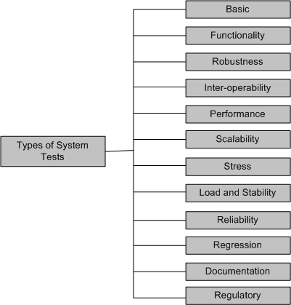
Taxonomy of System Tests
Figure 8.1: Types of system tests

Slide 4
Taxonomy of System Tests
Basic tests provide an evidence that the system can be installed, configured and be brought to an operational state
Functionality tests provide comprehensive testing over the full range of the requirements, within the capabilities of the system
Robustness tests determine how well the system recovers from various input errors and other failure situations
Inter-operability tests determine whether the system can inter-operate with other third party products
Performance tests measure the performance characteristics of the system, e.g., throughput and response time, under various conditions

Slide 5
Taxonomy of System Tests
Scalability tests determine the scaling limits of the system, in terms of user scaling, geographic scaling, and resource scaling
Stress tests put a system under stress in order to determine the limitations of a system and, when it fails, to determine the manner in which the failure occurs
Load and Stability tests provide evidence that the system remains stable for a long period of time under full load
Reliability tests measure the ability of the system to keep operating for a long time without developing failures
Regression tests determine that the system remains stable as it cycles through the integration of other subsystems and through maintenance tasks
Documentation tests ensure that the system’s user guides are accurate and usable

Slide 6
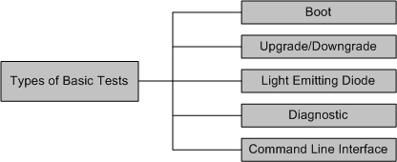
Basic Tests
Figure 8.2: Types of basic tests
Boot: Boot tests are designed to verify that the system can boot up its software image (or, build) from the supported boot options
Upgrade/Downgrade: Upgrade/downgrade tests are designed to verify that the system software can be upgraded or downgraded (rollback) in a graceful manner

Slide 7
Basic Tests
Light Emitting Diode: The LED (Light Emitting Diode) tests are designed to verify that the system LED status indicators functioning as desired
Diagnostic: Diagnostic tests are designed to verify that the hardware components (or, modules) of the system are functioning as desired
Power-On Self Test
Ethernet Loop Back Test
Bit Error Test
Command line Interface: Command Line Interface (CLI) tests are designed to verify that the system can be configured

Slide 8
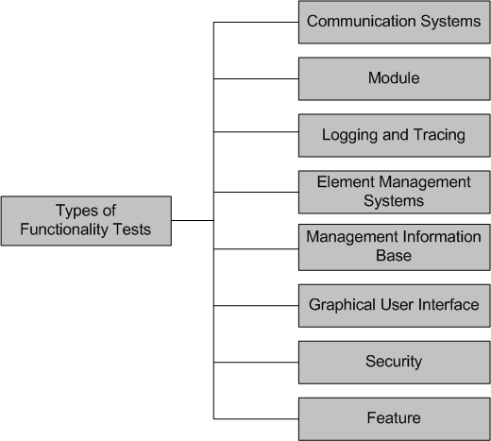
Functionality Tests
Figure 8.3: Types of functionality tests

Slide 9
Functionality Tests
Communication Systems Tests
These tests are designed to verify the implementation of the communication systems as specified in the customer requirements specification
Four types of communication systems tests are recommended
Basis interconnection tests
Capability tests
Behavior tests
System resolution tests
Module Tests
Module Tests are designed to verify that all the modules function individually as desired within the systems
The idea here is to ensure that individual modules function correctly within the whole system.
For example, an Internet router contains modules such as line cards, system controller, power supply, and fan tray. Tests are designed to verify each of the functionalities

Slide 10
Functionality Tests
Logging and Tracing Tests
Logging and Tracing Tests are designed to verify the configurations and operations of logging and tracing
This also includes verification of “flight data recorder: non-volatile Flash memory” logs when the system crashes
Element Management Systems (EMS) Tests
EMS tests verifies the main functionalities, which are to manage, monitor and upgrade the communication systems network elements
It includes both EMS client and EMS servers functionalities
Management Information Base (MIB) Tests
MIB tests are designed to verify
Standard MIBs including MIB II
Enterprise MIBs specific to the system

Slide 11
Functionality Tests
Graphical User Interface Tests
Tests are designed to look-and-feel the interface to the users of an application system
Tests are designed to verify different components such as icons, menu bars, dialog boxes, scroll bars, list boxes, and radio buttons
The GUI can be utilized to test the functionality behind the interface, such as accurate response to database queries
Tests the usefulness of the on-line help, error messages, tutorials, and user manuals
The usability characteristics of the GUI is tested, which includes the following
Accessibility: Can users enter, navigate, and exit with relative ease?
Responsiveness: Can users do what they want and when they want in a way that is clear?
Efficiency: Can users do what they want to with minimum number of steps and time?
Comprehensibility: Do users understand the product structure with a minimum amount of effort?
(Tools: TEstCOmplete, RAPISE,ABBOT Java GUI test framework

Slide 12
Screen Validations
Size and position of GUI elements
Clear and well-aligned images
Navigations (links)
Font and alignment of text
Date and numeric fields
Usability conditions and data integrity
Error messages
Required fields
Abbreviations inconsistencies
Progress bars
Shortcuts

Slide 13
Functionality Tests
Security Tests
Security tests are designed to verify that the system meets the security requirements
Confidentiality
It is the requirement that data and the processes be protected from unauthorized disclosure
Integrity
It is the requirement that data and process be protected from unauthorized modification
Availability
It is the requirement that data and processes be protected form the denial of service to authorized users
Security test scenarios should include negative scenarios such as misuse and abuse of the software system

Slide 14
Functionality Tests
Security Tests (cont’d) : useful types of security tests includes the following:
Verify that only authorized accesses to the system are permitted
Verify the correctness of both encryption and decryption algorithms for systems where data/messages are encoded.
Verify that illegal reading of files, to which the perpetrator is not authorized, is not allowed
Ensure that virus checkers prevent or curtail entry of viruses into the system
Ensure that the system is available to authorized users when a zero-day attack occurs
Try to identify any “backdoors” in the system usually left open by the software developers

Slide 15
Functionality Tests
Feature Tests
These tests are designed to verify any additional functionalities which are defined in requirement specification but not covered in the functional category discussed
Examples
Data conversion testing
Cross-functionality testing

Slide 16
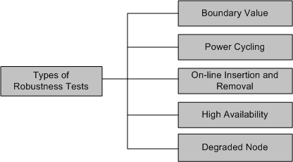
Robustness Tests
Robustness means how much sensitive a system is to erroneous input and changes its operational environment
Tests in this category are designed to verify how gracefully the system behaves in error situations and ina a changed operational environment
Figure 8.4: Types of robustness tests

Slide 17
Robustness Tests
Boundary value
Boundary value tests are designed to cover boundary conditions, special values, and system defaults
The tests include providing invalid input data to the system and observing how the system reacts to the invalid input.
Power cycling
Power cycling tests are executed to ensure that, when there is a power glitch in a deployment environment, the system can recover from the glitch to be back in normal operation after power is restored
On-line insertion and removal
On-line Insertion and Removal (OIR) tests are designed to ensure that on-line insertion and removal of modules, incurred during both idle and heavy load operations, are gracefully handled and recovered

Slide 18
Robustness Tests
High Availability
The concept of high availability is also known as fault tolerance
High availability tests are designed to verify the redundancy of individual modules, including the software that controls these modules.
The goal is to verify that the system gracefully and quickly recovers from hardware and software failures without adversely impacting the operation of the system
High availability is realized by means of proactive methods to maximize service up-time, and to minimize the downtime
Degraded Node
Degraded node (also known as failure containment) tests verify the operation of a system after a portion of the system becomes non-operational
It is a useful test for all mission-critical applications.

Slide 19
Interoperability Tests
Tests are designed to verify the ability of the system to inter-operate with third party products
The re-configuration activities during interoperability tests is known as configuration testing
Another kind of inter-operability tests is called (backward) compatibility tests
Compatibility tests verify that the system works the same way across different platforms, operating systems, data base management systems
Backward compatibility tests verify that the current software build flawlessly works with older version of platforms

Slide 20
Performance Tests
Tests are designed to determine the performance of the actual system compared to the expected one
Tests are designed to verify response time, execution time, throughput, resource utilization and traffic rate
One needs to be clear about the specific data to be captured in order to evaluate performance metrics.
For example, if the objective is to evaluate the response time, then one needs to capture
End-to-end response time (as seen by external user)
CPU time
Network connection time
Database access time
Network connection time
Waiting time

Slide 21
Scalability Tests
Tests are designed to verify that the system can scale up to its engineering limits
Scaling tests are conducted to ensure that the system response time remains the same, or increases by a small amount, as the number of users are increased.
There are three major causes of these limitations:
data storage limitations
network bandwidth limitations
speed limit
Extrapolation is often used to predict the limit of scalability

Slide 22
Stress Tests
The goal of stress testing is to evaluate and determine the behavior of a software component while the offered load is in excess of its designed capacity
The system is deliberately stressed by pushing it to and beyond its specified limits
It ensures that the system can perform acceptably under worst-case conditions, under an expected peak load. If the limit is exceeded and the system does fail, then the recovery mechanism should be invoked
Stress tests are targeted to bring out the problems associated with one or more of the following:
Memory leak
Buffer allocation and memory carving

Slide 23
Load and Stability Tests
Tests are designed to ensure that the system remains stable for a long period of time under full load
When a large number of users are introduced and applications that run for months without restarting, a number of problems are likely to occur:
the system slows down
the system encounters functionality problems
the system crashes altogether
Load and stability testing typically involves exercising the system with virtual users and measuring the performance to verify whether the system can support the anticipated load
This kind of testing help one to understand the ways the system will fare in real-life situations (Jmeter, Loadruner)

Slide 24
Reliability Tests
Reliability tests are designed to measure the ability of the system to remain operational for long periods of time.
The reliability of a system is typically expressed in terms of mean time to failure (MTTF)
The average of all the time intervals between successive failures is called the MTTF
After a failure is observed, the developers analyze and fix the defects, which consumes some time – let us call this interval the repair time.
The average of all the repair times is known as the mean time to repair (MTTR)
Now we can calculate a value called mean time between failure (MTBF) as MTBF = MTTF + MTTR
The random testing technique discussed in Chapter 9 is used for reliability measurement
The software reliability modeling and testing is discussed in Chapter 15 in detail

Slide 25
Regression Tests
In this category, new tests are not designed, instead, test cases are selected from the existing pool and executed
The main idea in regression testing is to verify that no defect has been introduced into the unchanged portion of a system due to changes made elsewhere in the system
During system testing, many defects are revealed and the code is modified to fix those defects
One of four different scenarios can occur for each fix:
The reported defect is fixed
The reported defect could not be fixed inspite of making an effort
The reported defect has been fixed, but something that used to work before has been failing
The reported defect could not be fixed inspite of an effort, and something that used to work before has been failing

Slide 26
Documentation Tests
Documentation testing means verifying the technical accuracy and readability of the user manuals, tutorials and the on-line help
Documentation testing is performed at three levels:
Read test: In this test a documentation is reviewed for clarity, organization, flow, and accuracy without executing the documented instructions on the system
Hands-on test: Exercise the on-line help and verify the error messages to evaluate their accuracy and usefulness.
Functional test: Follow the instructions embodied in the documentation to verify that the system works as it has been documented.

Slide 27
Regulatory Tests
In this category, the final system is shipped to the regulatory bodies in those countries where the product is expected to be marketed
The idea is to obtain compliance marks on the product from various countries
Most of these regulatory bodies issue safety and EMC (electromagnetic compatibility)/ EMI (electromagnetic interference) compliance certificates (emission and immunity)
The regulatory agencies are interested in identifying flaws in software that have potential safety consequences
The safety requirements are primarily based on their own published standards

Slide 28
Software Safety
A hazard is a state of a system or a physical situation which when combined with certain environmental conditions, could lead to an accident or mishap
An accident or mishap is an unintended event or series of events that results in death, injury, illness, damage or loss of property, or harm to the environment
Software safety is defined in terms of hazards
A software in isolation cannot do physical damage. However, a software in the context of a system and an embedding environment could be vulnerable
Examples:
A software module in a database application is not hazardous by itself, but when it is embedded in a missile navigation system, it could be hazardous
If a missile takes a U-turn because of a software error in the navigation system, and destroys the submarine that launched it, then it is not a safe software

Slide 29
Safety Assurance
There are two basic tasks performed by a safety assurance engineering team:
Provide methods for identifying, tracking, evaluating, and eliminating hazards associated with a system
Ensure that safety is embedded into the design and implementation in a timely and cost-effective manner, such that the risk created by the user/operator error is minimized

Slide 30
Thank You!!

